Slide 1
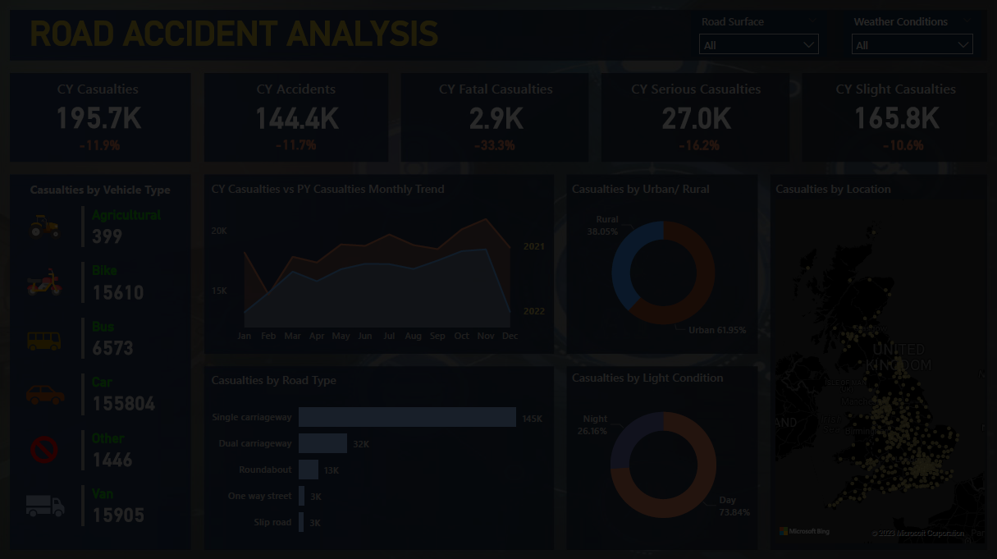

STEPS IN PROJECT
Requirement Gathering
Stakeholders in Project
Raw Data Overview
Connecting Data with Power BI
Data Cleaning
Data Processing
Data Modelling
Background Design in Power Point
Data Visualization/ Charts Design
Report/ Dashboard Building
Insights

Slide 2
REQUIREMENT
Clients wants to create a Road Accident Dashboard for year 2021 and 2022 so that they can have insight on the below requirements-
Primary KPI - Total Casualties and Total Accident values for Current Year and YoY growth
Primary KPI’s – Total Casualties by Accident Severity for Current Year and YoY growth
Secondary KPI’s - Total Casualties with respect to vehicle type for Current Year
Monthly trend showing comparison of casualties for Current Year and Previous Year
Casualties by Road Type for Current year
Current Year Casualties by Area/ Location & by Day/ Night
Total Casualties and Total Accidents by Location

Slide 3
STAKEHOLDERS
Ministry of Transport
Road Transport Department
Police Force
Emergency Services Department
Road Safety Corps
Transport Operators
Traffic Management Agencies
Public
Media

Slide 4
POWER BI FUNCTIONALITIES
How to connect to raw data/ flat file
Data Cleaning in Power Query
Data Processing
Time Intelligence Function/ Calendar Date Table in Power BI
Data Modelling (Relationship between multiple tables)
YTD and YoY Growth Calculations using DAX
KPI and Advanced KPI Generations
Creating custom columns and measures in the reports
Importing Images
Creating different charts and generating insights
Export the Report to users

